Slide 1


Scalable Graph Neural Networks via Bidirectional Propagation
NeurIPS 2020
Ming Chen, Zhewei Wei,
Bolin Ding, Yaliang Li,
Ye Yuan, Xiaoyong Du, Ji-Rong Wen

Slide 2
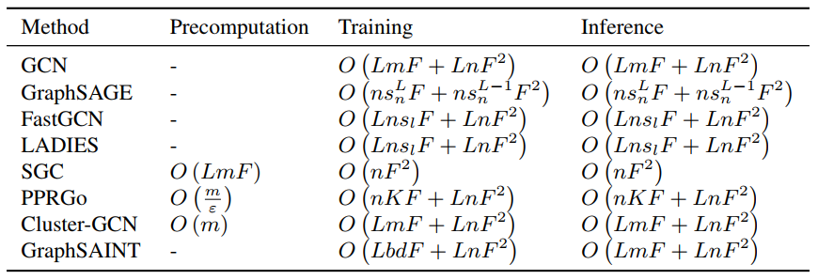
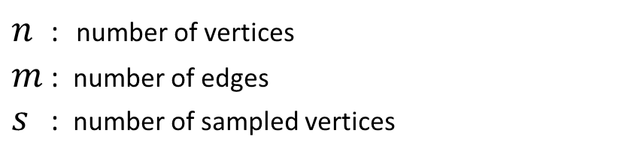
Existing works
$n$ : number of vertices
$m$ : number of edges
$s$ : number of sampled vertices
Full batch

Slide 3
Existing works
$n$ : number of vertices
$m$ : number of edges
$s$ : number of sampled vertices
Full batch
Layer sampling
Linear
Graph sampling

Slide 4

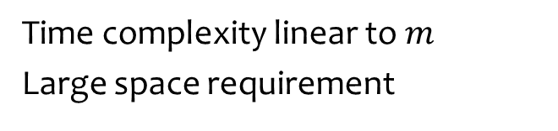
Existing works
$n$ : number of vertices
$m$ : number of edges
$s$ : number of sampled vertices
Full batch
Layer sampling
Linear
Graph sampling
Time complexity linear to $m$
Large space requirement

Slide 5
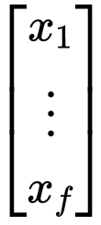
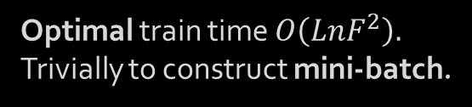
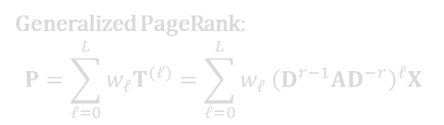
Graph Neural Networks via Bidirectional Propagation
Predict
ReLU
transformation
Optimal train time $O\left(LnF^{2}\right).$
Trivially to construct mini-batch.
ReLU
feature
propagation
Generalized PageRank:
$$P=\sum_{𝓁=0}^{L}{w_{𝓁}T^{(𝓁)}=\sum_{𝓁=0}^{L}{w_{𝓁}}{\left(D^{r−1}AD^{−r}\right)}^{𝓁}X}$$

Slide 6
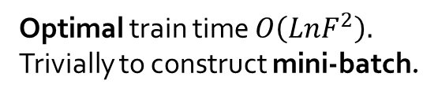
Graph Neural Networks via Bidirectional Propagation
Predict
ReLU
transformation
Optimal train time $O\left(LnF^{2}\right).$
Trivially to construct mini-batch.
ReLU
feature
propagation
Generalized PageRank:
$$P=\sum_{𝓁=0}^{L}{w_{𝓁}T^{(𝓁)}=\sum_{𝓁=0}^{L}{w_{𝓁}}{\left(D^{r−1}AD^{−r}\right)}^{𝓁}X}$$

Slide 7
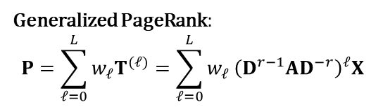
Graph Neural Networks via Bidirectional Propagation
Predict
ReLU
transformation
Optimal train time $O\left(LnF^{2}\right).$
Trivially to construct mini-batch.
ReLU
feature
propagation
Generalized PageRank:
$$P=\sum_{𝓁=0}^{L}{w_{𝓁}T^{(𝓁)}=\sum_{𝓁=0}^{L}{w_{𝓁}}{\left(D^{r−1}AD^{−r}\right)}^{𝓁}X}$$

Slide 8
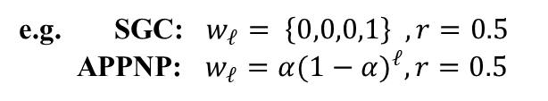
Graph Neural Networks via Bidirectional Propagation
Predict
ReLU
transformation
Optimal train time $O\left(LnF^{2}\right).$
Trivially to construct mini-batch.
ReLU
feature
propagation
Generalized PageRank:
$$P=\sum_{𝓁=0}^{L}{w_{𝓁}T^{(𝓁)}=\sum_{𝓁=0}^{L}{w_{𝓁}}{\left(D^{r−1}AD^{−r}\right)}^{𝓁}X}$$
e.g. SGC: $w_{𝓁}= \left\{0,0,0,1\right\} , r=0.5$
APPNP: $w_{𝓁}=α{(1−α)}^{ℓ},r=0.5$

Slide 9


Bidirectional Propagation
feature vector
0.003
0.09
…
0.5
0.001
0.1
0.009
0.002
…
0.01
0.001
0.002
training node
$$X[:,0]$$
…
$$X[:,−1]$$

Slide 10
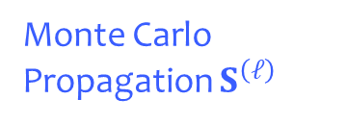
Bidirectional Propagation
Monte Carlo Propagation $S^{\left(ℓ\right)}$
feature vector
0.003
0.09
…
0.5
0.001
0.1
0.009
0.002
…
0.01
0.001
0.002
training node
$$X[:,0]$$
…
$$X[:,−1]$$

Slide 11
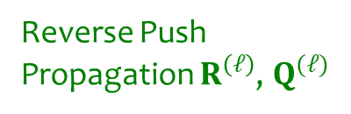
Bidirectional Propagation
Reverse Push
Propagation $R^{\left(ℓ\right)}$, $Q^{(ℓ)}$
Monte Carlo Propagation $S^{\left(ℓ\right)}$
feature vector
0.003
0.09
…
0.5
0.001
0.1
0.009
0.002
…
0.01
0.001
0.002
training node
$$X[:,0]$$
…
$$X[:,−1]$$

Slide 12

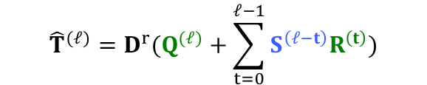
Bidirectional Propagation
Reverse Push
Propagation $R^{\left(ℓ\right)}$, $Q^{(ℓ)}$
Monte Carlo Propagation $S^{\left(ℓ\right)}$
feature vector
0.003
0.09
…
0.5
0.001
0.1
0.009
0.002
…
0.01
0.001
0.002
meet
training node
$${\hat{T}}^{(ℓ)}=D^{r}(Q^{(ℓ)}+\sum_{t=0}^{ℓ−1}{S^{\left(ℓ−t\right)}R^{\left(t\right)}})$$
$$X[:,0]$$
…
$$X[:,−1]$$
$${\left(D^{r−1}AD^{−r}\right)}^{ℓ}X$$

Slide 13
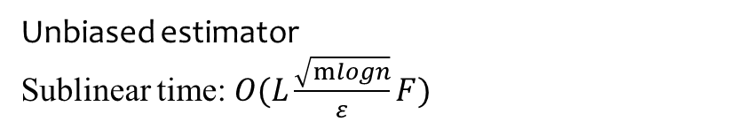
Bidirectional Propagation
Reverse Push
Propagation $R^{\left(ℓ\right)}$, $Q^{(ℓ)}$
Monte Carlo Propagation $S^{\left(ℓ\right)}$
feature vector
0.003
0.09
…
0.5
0.001
0.1
0.009
0.002
…
0.01
0.001
0.002
meet
training node
$${\hat{T}}^{(ℓ)}=D^{r}(Q^{(ℓ)}+\sum_{t=0}^{ℓ−1}{S^{\left(ℓ−t\right)}R^{\left(t\right)}})$$
$$X[:,0]$$
…
$$X[:,−1]$$
Unbiased estimator
Sublinear time: $O(L\frac{\sqrt{mlogn}}{ε}F)$
$${\left(D^{r−1}AD^{−r}\right)}^{ℓ}X$$

Slide 14
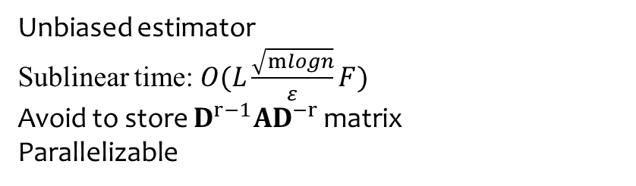
Bidirectional Propagation
Reverse Push
Propagation $R^{\left(ℓ\right)}$, $Q^{(ℓ)}$
Monte Carlo Propagation $S^{\left(ℓ\right)}$
feature vector
0.003
0.09
…
0.5
0.001
0.1
0.009
0.002
…
0.01
0.001
0.002
meet
training node
$${\hat{T}}^{(ℓ)}=D^{r}(Q^{(ℓ)}+\sum_{t=0}^{ℓ−1}{S^{\left(ℓ−t\right)}R^{\left(t\right)}})$$
$$X[:,0]$$
…
$$X[:,−1]$$
Unbiased estimator
Sublinear time: $O(L\frac{\sqrt{mlogn}}{ε}F)$
Avoid to store $D^{r−1}AD^{−r}$ matrix
Parallelizable
$${\left(D^{r−1}AD^{−r}\right)}^{ℓ}X$$

Slide 15
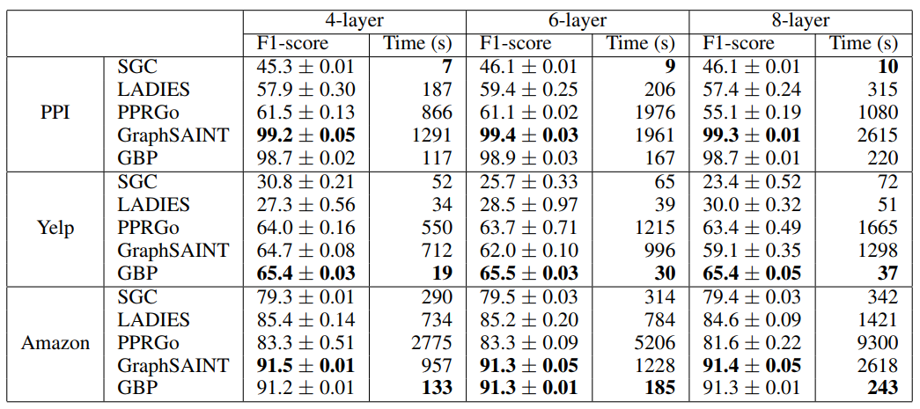
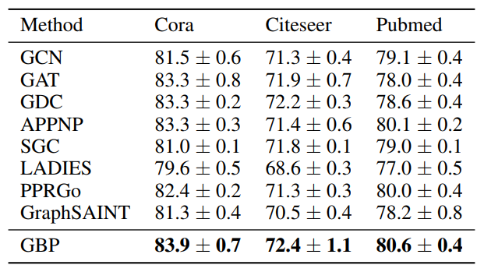
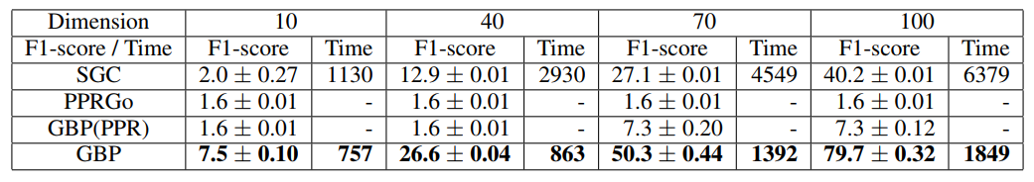
Experiments

Slide 16
Thank you!
NeurIPS 2020
Scalable Graph Neural Networks via Bidirectional Propagation

